Slide 1
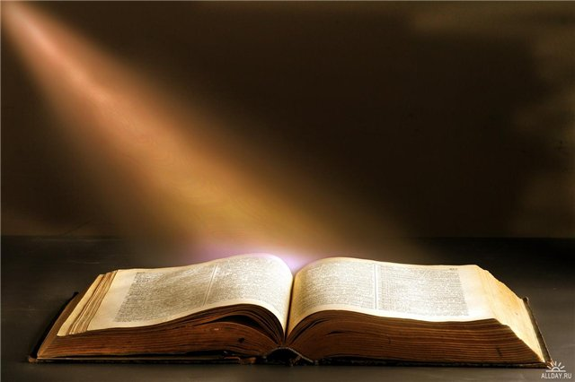
From very beginning of our life we are closely connected with books.

Slide 2
The world of books is rich and various. Books are the greatest of the world’s wonders. They give us a unique chance to link up with authors who lived hundreds and thousands years ago. Through reading we hear the voices, thoughts and feelings of different people. The book is the surest way to bring the whole nations together. Some books arouse our emotions such as feelings of sympathy or admiration, some we read for studies and instruction, some are a source of relaxation.

Slide 3
My reading habits
I enjoy/hate reading.
In my opinion books develop my imagination and/or enrich knowledge about the world.
I believe books teach me to be kind/clever/hard-working, friendly/help the other people/to love Motherland.
I find reading very/quite/rather/not at all relaxing/boring/interesting/entertaining…
If I have time and desire to read I do it (every day, once a week, very often, quite seldom) and I devote…to reading.

