Slide 1
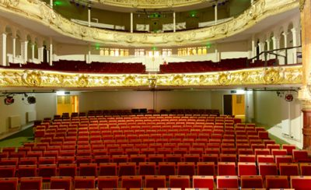
HOW TO DESCRIBE THE LAST VISIT TO THE THEATRE
Last time I was at the theatre (when, where, who with, why, what)…..
It was a comedy/tragedy/ the premiere….
We bought the tickets in advance / just before the play….
and came to the theatre half an hour before the show/ were late for the show.
You could hardly/easily find a vacant seat.
At 7 sharp the performance began.
From the very first minute I was deeply impressed/irritated by everything I saw on the stage.

Slide 2
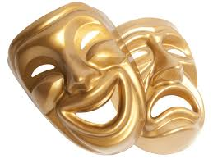
HOW TO DESCRIBE THE LAST VISIT TO THE THEATRE
The costumes were fine/ugly and untidy.
The songs/dancing and music was thrilling/monotonous/soapy.
I had never seen anything more wonderful/boring.
My friend also enjoyed/hated every minute of it.
When the curtain fell at the end of the performance there came a storm of applause/a complete silence.
It seemed that it would never end.
The singers/actors dancers received call after call.
They were/n’t presented with large bouquets of flowers.
We also applauded enthusiastically/lazily.
The play (performance) was/not a great success.
I was glad I didn’t miss the premiere. I enjoyed every minute of it.

